Slide 1

Exploratory Data Analysis on Factors Affecting Attrition
Submitted by
Aswin Kumar D22010

Slide 2





What we are trying to find?
Why we are trying to find?
Top talent, in particular, can be very difficult and expensive to replace
The more talented the worker, the greater the consequences of attrition
1
Who is leaving?
2
When they are leaving?
Replacing an individual employee typically costs 1.5 to 2 times the worker’s annual salary
Businesses are better off when they can retain good employees & the organizational knowledge they possess
3
Why they are leaving?
Employee attrition analytics is specifically focused on identifying why employees voluntarily leave, what might have prevented them from leaving, and how we can use data to predict attrition risk
The accepted standard attrition rate for an organization across the world is considered to be 10%. But here we see that the attrition rate for our organization to be 16%. Since the attrition rate far exceeds the accepted standard, therefore we are performing this analysis.
The goal with employee attrition & retention is to strike the right balance of holding on to top talent while accepting that some level of attrition is healthy; employee attrition analytics enables organizations to find that balance
1

Slide 3
Categorical & Numerical Variables
Categorical
Continuous
Dist from Home
Discrete
Department
Age
Business
Travel
Monthly
Income
Education
Field
Attrition
Environment
Satisfaction
Gender
Over Time
Years in Current Role
Marital Status
Job
Involvement
Work Life Balance
Years at Company
Years with Current manager
Job Level
Job Satisfaction
Total Working Years
Years since last promotion
2

Slide 4

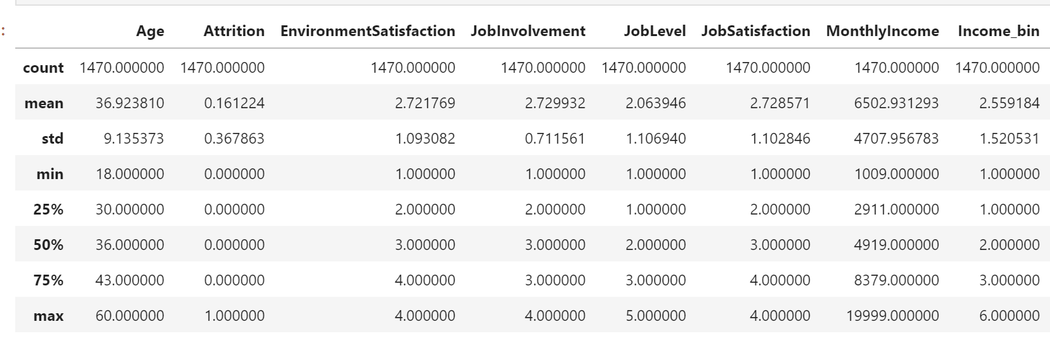
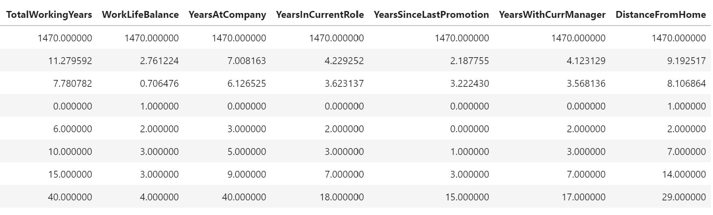

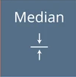


Univariate Analysis
The median salary is much lower than the mean salary of the employees under our analysis.
Therefore majority of the people in our organization earn less than the mean salary
More than 70 % of the people in our organization do not do overtime, the reason of which is subject to further analysis
Married & divorced people make more than two thirds of the employees in the organization
This may affect the number of people doing overtime or travelling less frequently in our company
More than 80 % of the employees in our organization either do not travel or travel less frequently
3

Slide 5
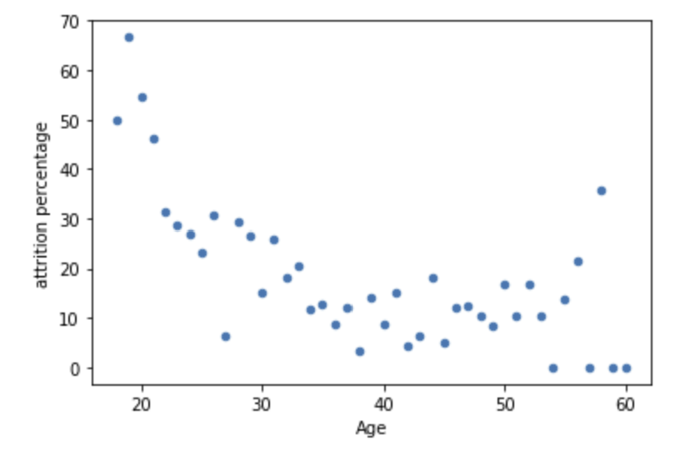
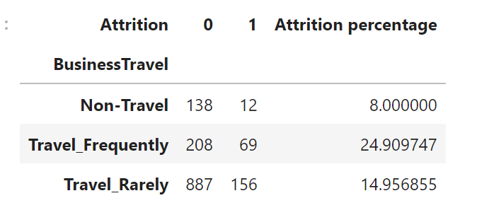
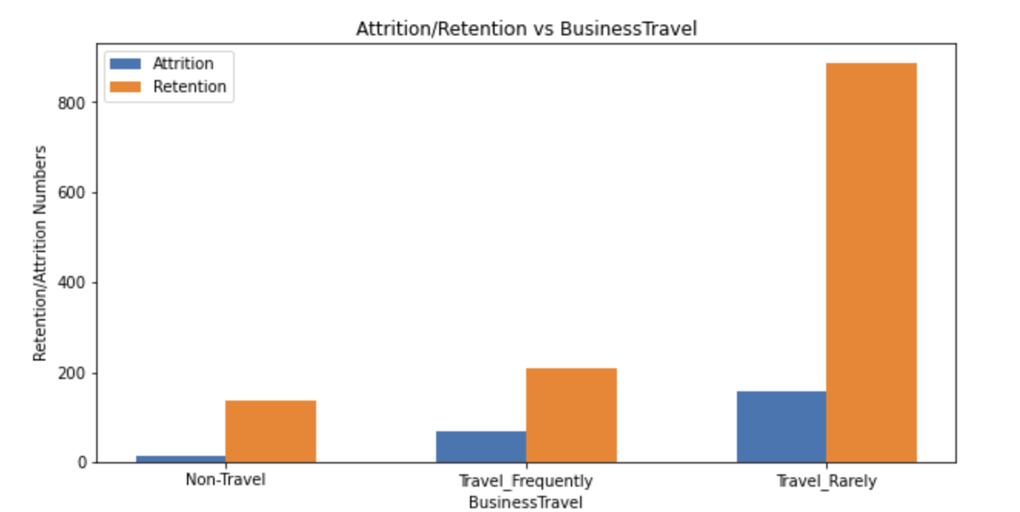


Bi-Variate Analysis
Age vs Attrition
Business Travel vs Attrition
Inference
Inference
Higher attrition rate is strongly associated with lower age group & decreases with increasing age
Age 18 to age 26 have exceedingly higher rate of attrition compared to other age groups
The attrition rate among employees in our company who travel frequently is comparatively higher than those who travel less or don't travel at all
Interpretation
Interpretation
Employees who are younger are less likely to be married & so have lesser commitments. So they are open to taking risks
Employees who travel frequently are getting exposed to several opportunities & so they are more likely to switch jobs
Employees who travel frequently have an impact in their work life balance, health & so they shift towards lesser taxing jobs
4

Slide 6
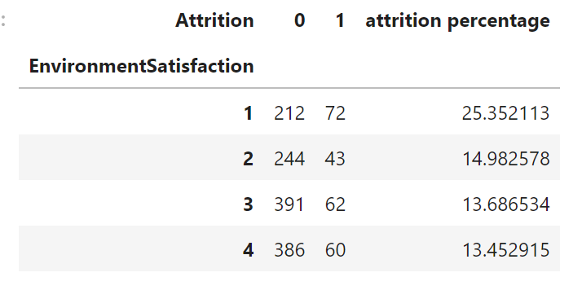
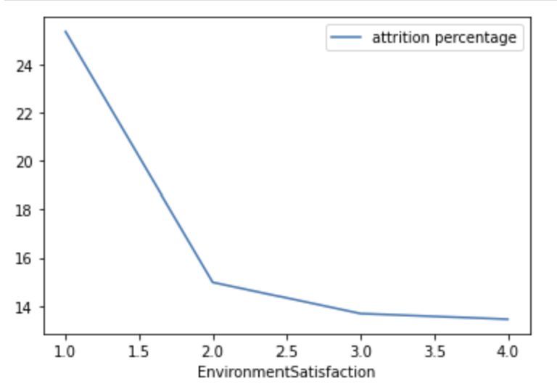
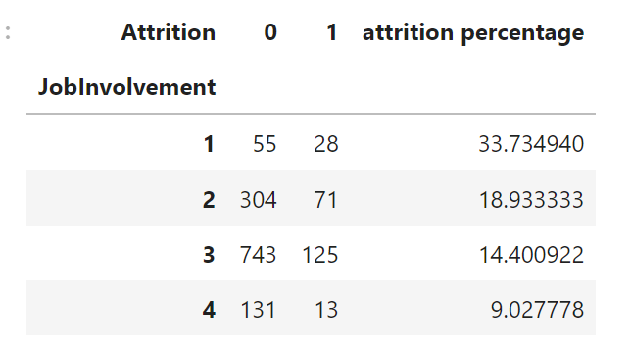
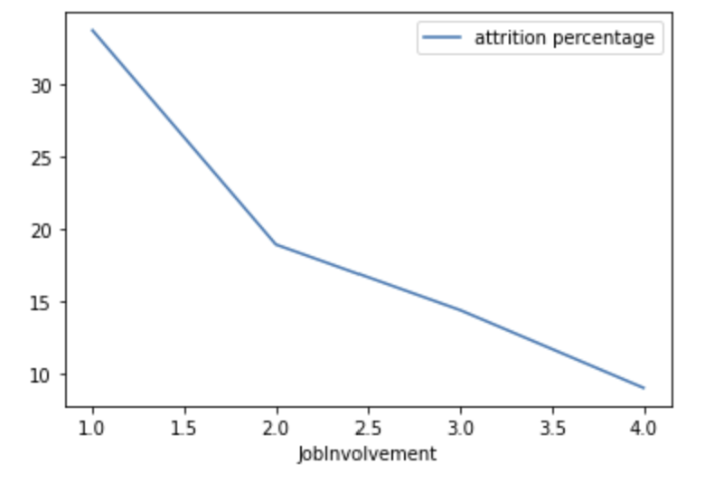
Bi-Variate Analysis
Environmental Satisfaction vs Attrition
Job Involvement vs Attrition
Inference
Inference
Higher attrition rate is associated with lower Environment Satisfaction in our organization
Job Involvement has a strong negative association with attrition rate in our organization
Interpretation
Interpretation
Employees tend to leave the company when their work environment is absolutely the lowest. This may be due to:
Poor work culture
Discrimination & bias of any form
Poor hospitality
Job involvement is a rating given by managers to their employees. 1. So it's not quite surprising to see employees leaving our company or getting fired due to low job involvement
2. Weak hiring process – mismatch of employee skillset to the job requirement
5

Slide 7
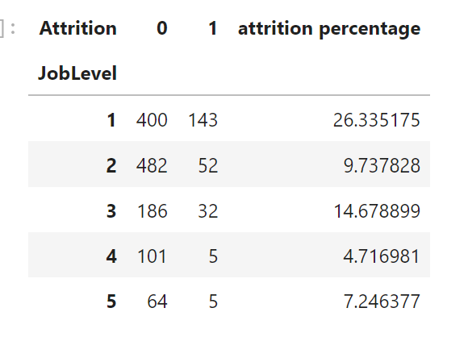
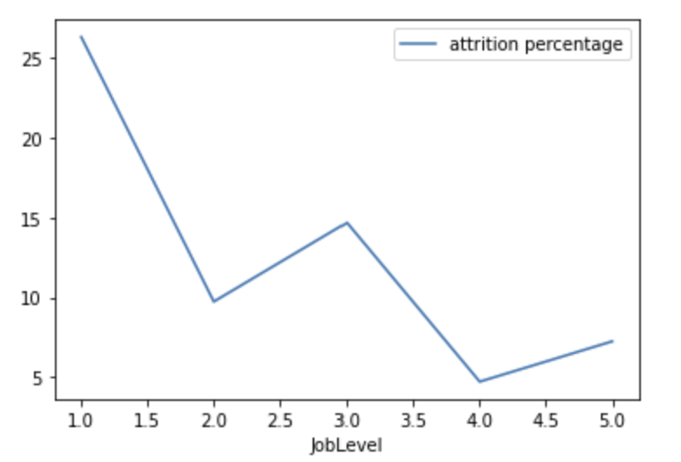
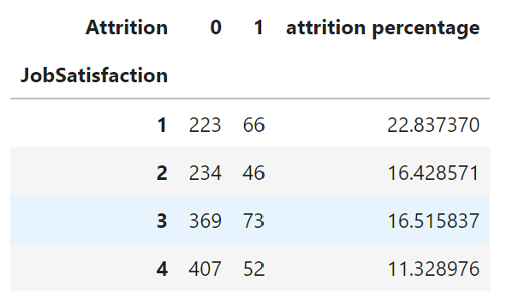
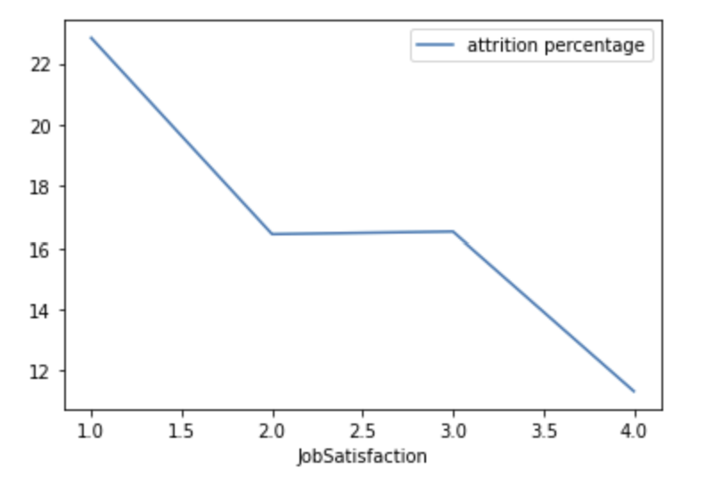
Bi-Variate Analysis
Job Level vs Attrition
Job Satisfaction vs Attrition
Inference
Inference
Attrition rate has a negative association with Job Level of employees in our organization i.e. Higher the job level lower the rate of attrition
Attrition rate has a negative association with Job Satisfaction of employees in our organization
Interpretation
Interpretation
Employees beginning their careers typically tend to be single & without any family commitments. So they can take the risk of going after better opportunities & change in domain or sector as this is possible only at the early career stage
Employees at Job level 3 are those who probably leave after gaining enough experience & skillset as they have higher job opportunities in the outside market
Employees in our organization are less satisfied with their jobs due to several reasons. Some may be:
1. Lower Monthly Income
2. Over Time
3. Poor Work Environment
4. Mismatch of personal interest and current job profile
6

Slide 8
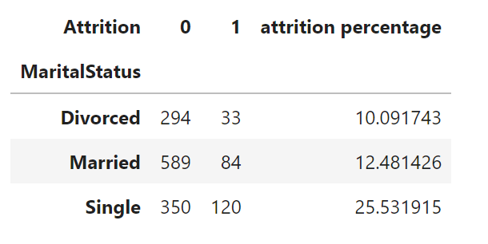
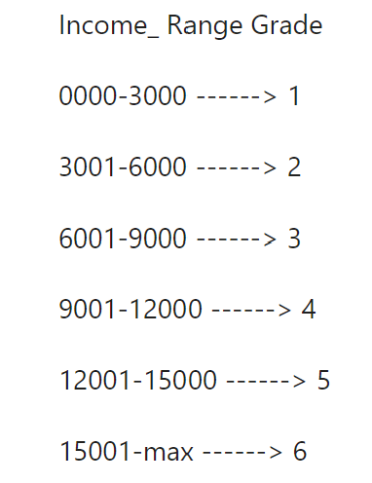
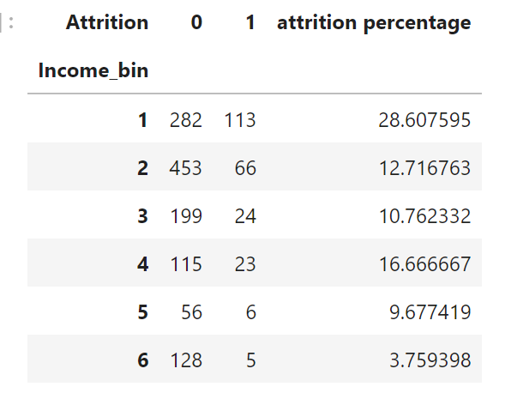
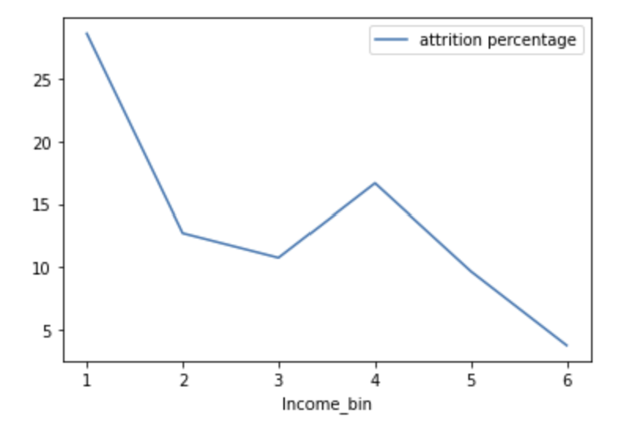
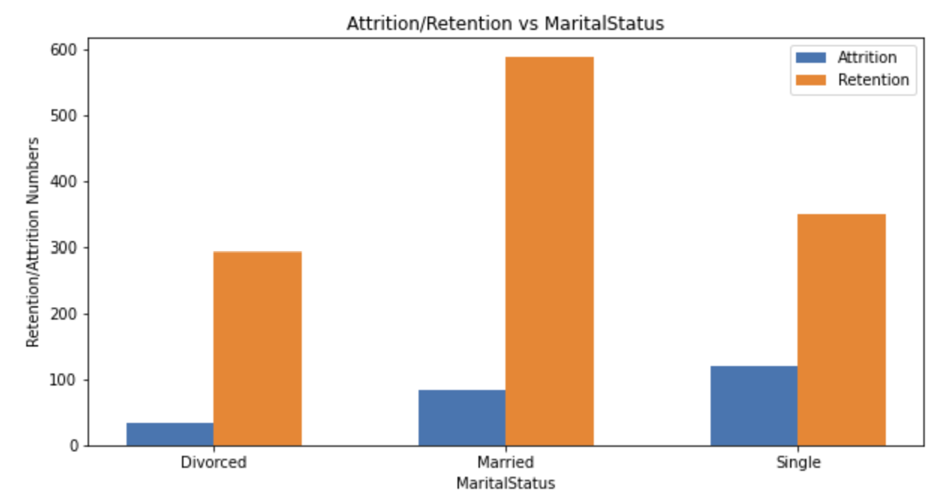
Bi-Variate Analysis
Marital Status vs Attrition
Monthly Income vs Attrition
Inference
Attrition rate has a strong association with the monthly income of employees in our organization
Interpretation
Employees with mid-level income tend to leave the company so as to get higher pay before settling down
Typically employees at a higher pay slab will also be at a higher job level & job opportunities will be saturated compared to lower-paying jobs. So they don’t switch jobs that easily
Inference
Interpretation
Attrition rate has a strong association with single employees in our organization
This can be attributed to the possibility that single people have lesser personal commitments and therefore can take the risk of switching various jobs
7

Slide 9
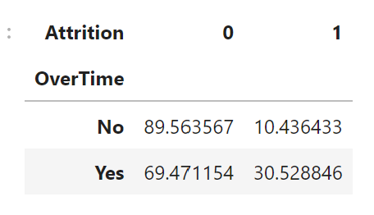
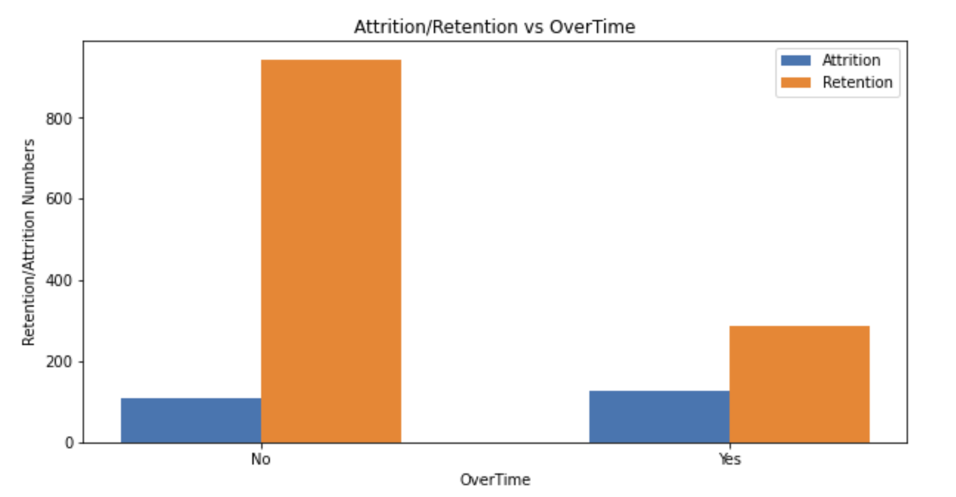
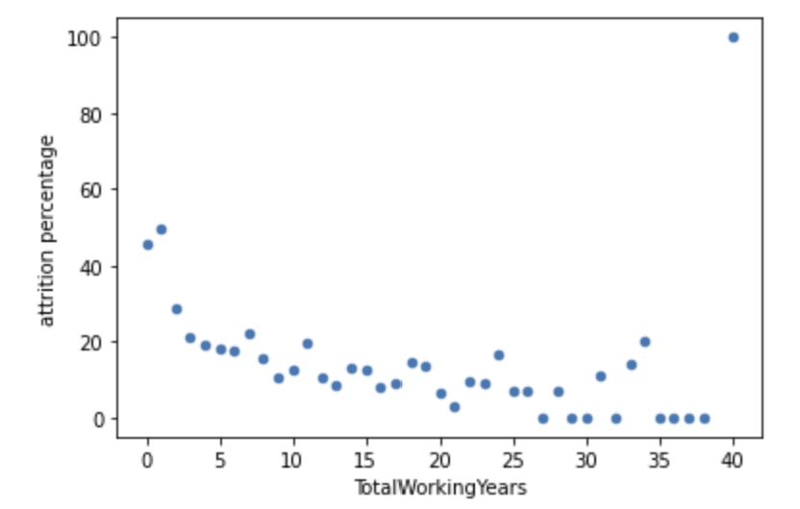
Bi-Variate Analysis
Over Time vs Attrition
Total Working Years vs Attrition
Inference
Inference
Attrition rate has a strong positive association with employees being subjected to overtime in our organization
Attrition rate in our organization has a moderate negative correlation with the attrition rate
Interpretation
Interpretation
Out of 30% of employees in our organization who are performing over time, 29% tend to leave their job. This may be due to:
Notion of being underpaid and at the same time being extracted more work
Being subjected to over-time under compulsion from higher authorities
This can be attributed to the possibility that 0-2 years experienced will be relatively young & have lesser personal commitments and therefore can take the risk of switching various jobs
8

Slide 10
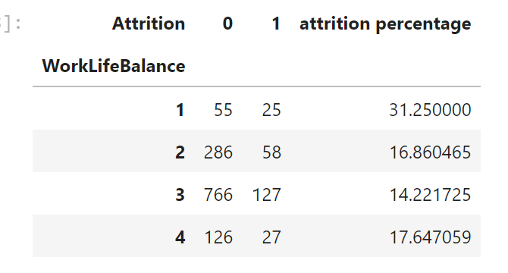
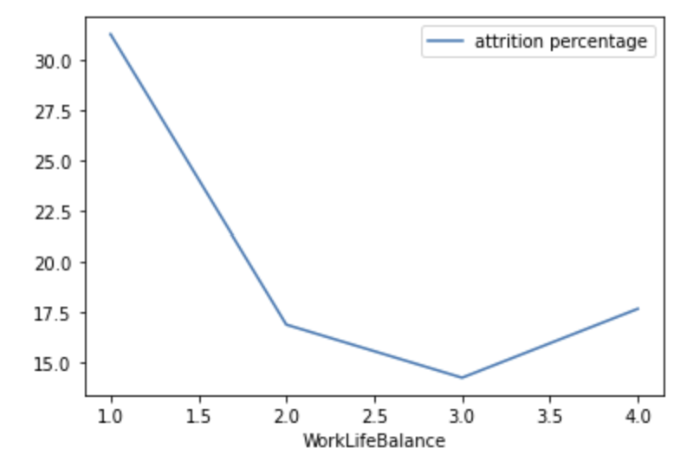
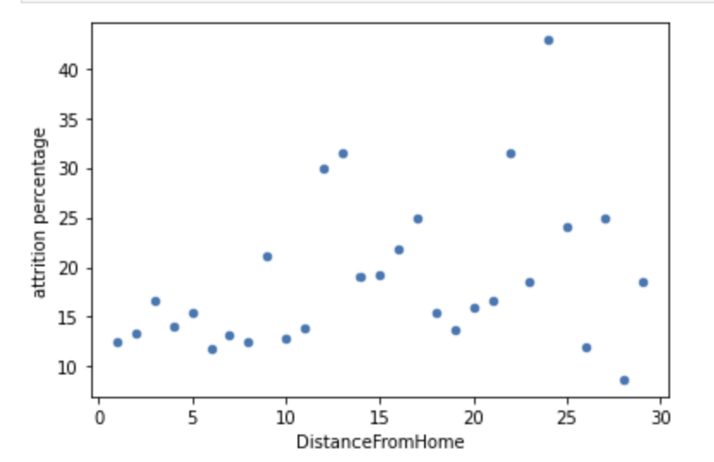
Bi-Variate Analysis
Work Life Balance vs Attrition
Distance From Home vs Attrition
Inference
Inference
Employees in our organization have the highest attrition rate when their work life balance is the lowest. The attrition rate for work life balance more than 1 is almost similar
As per the analysis done above, there is no such association between attrition rate in our company and distance from home of employees which is quite surprising
Interpretation
Interpretation
This can be due to various reasons like work pressure, work after leaving the office, available 24/7
Employees also leave when they have the highest & perfect work life balance possibly due to stagnation in learning & getting too comfortable with their job which makes them go in search of the new thrill in their life
Some employees may prioritise salary, learning & work culture over distance
Some employees may prioritise distance which ultimately leads to better work life balance
9

Slide 11
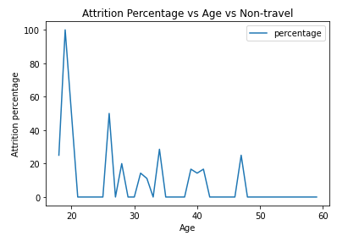
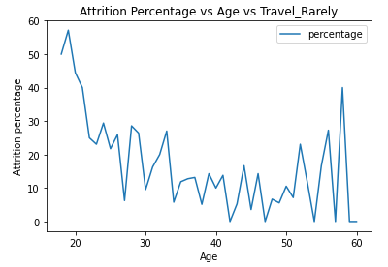
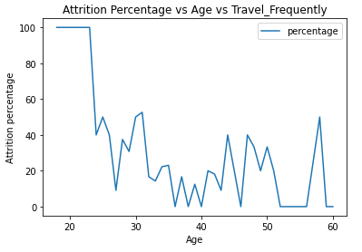
Multi-Variate Analysis
Attrition vs Age vs Business Travel
Inference
Attrition percentage is higher among older employees who travel frequently & who travel rarely
Irrespective of the level of business travel, younger employees prefer to switch jobs.
Interpretation
An older employee probably does not prefer to travel frequently or travel at all. This can be due to :
1. Physical fatigue associated with aging
2. Probably they are married and have higher commitments than younger people.
Older employees are more health conscious compared to younger ones and probably may not like being exposed to different food, drinking water & other health requirements
10

Slide 12
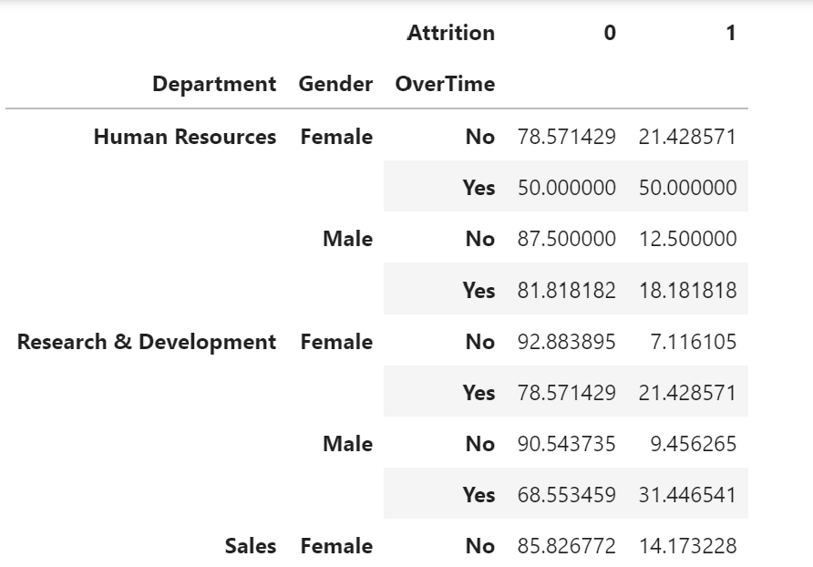
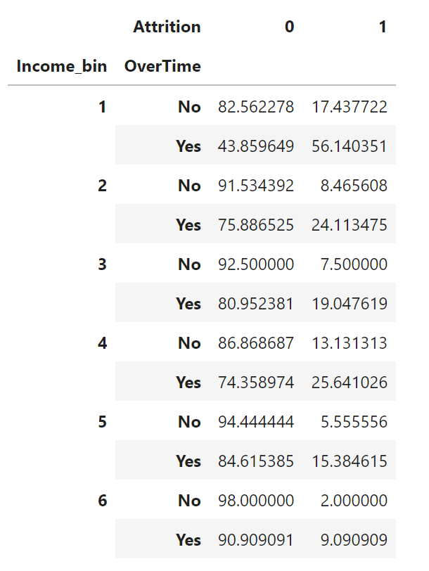
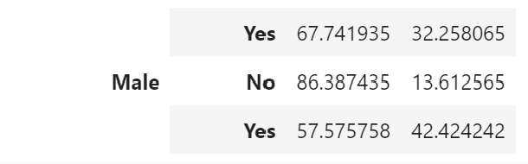
Multi-Variate Analysis
Department vs Gender vs Overtime vs Attrition
Income Bin vs Overtime vs Attrition
Inference
Inference
A female employee from the HR department and a male employee from Sales Department in our organization when being subjected to overtime are more likely to leave the organization compared to his/her counterparts in other departments.
Attrition percentage of employees in our organization
who belong to the lower pay slab and when subjected to overtime are higher compared to those earning more
Interpretation
Interpretation
The probability of a female employee being subjected to overtime is the same across all departments, while the probability she leaves the organization given she works in the HR department is higher. This must be due to some other factors like discrimination or lower pay or gender bias which needs to be investigated.
This may be due to the following reasons:
1. An employee in lower pay slabs, consider themselves to be underpaid and simultaneously being exploited
2. Higher-paid employees preferably take remuneration as their primary consideration.
11

Slide 13
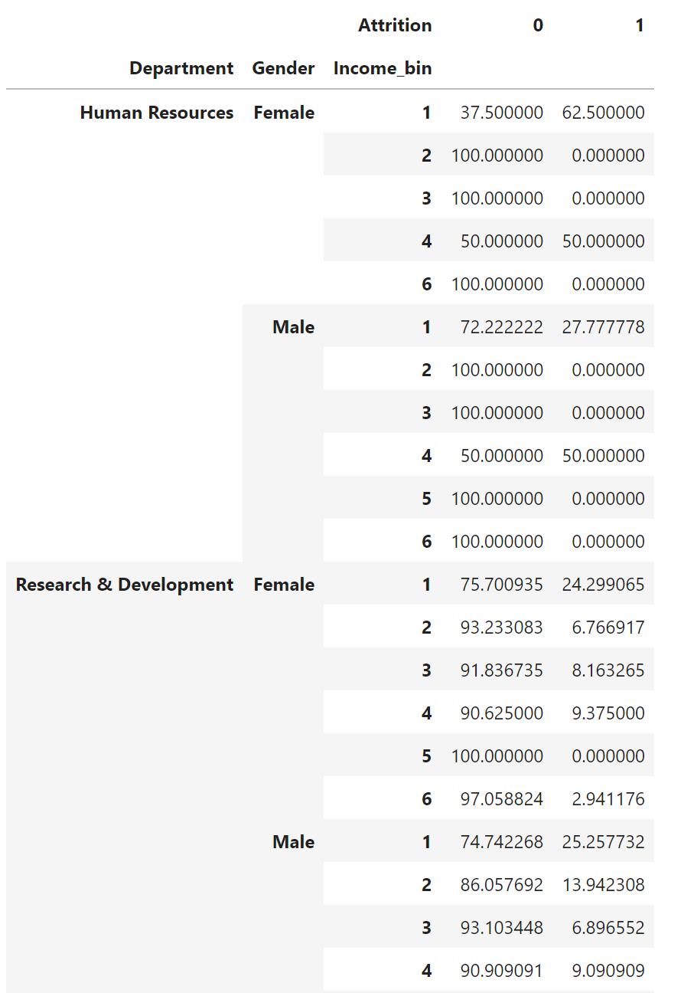
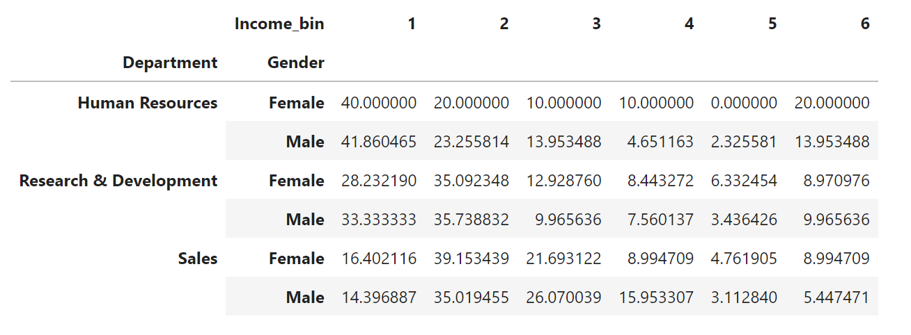
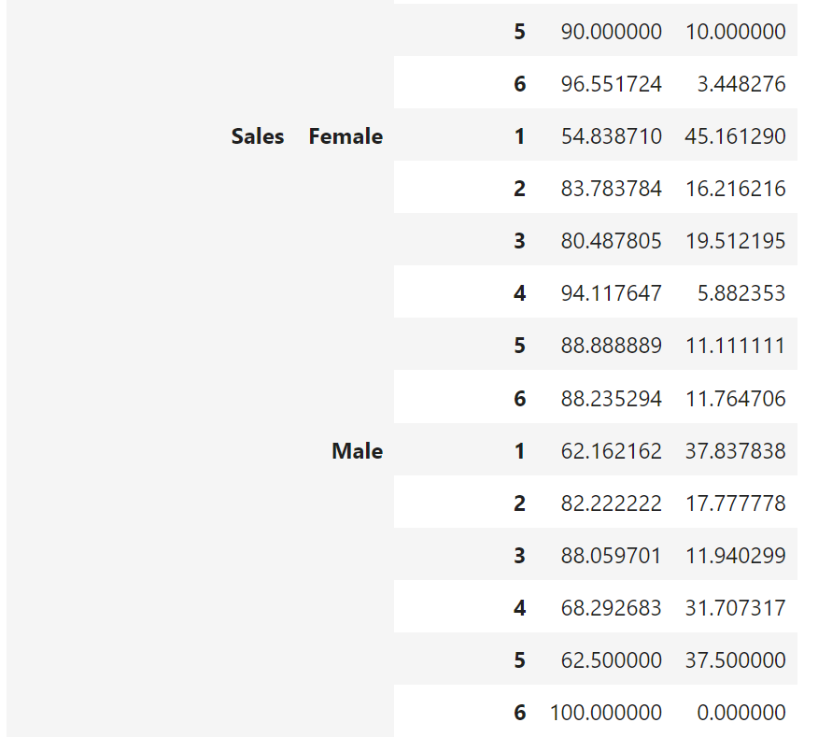
Multi-Variate Analysis
Analysis of Attrition in the Human Resources department
Department vs Gender vs Income Bin vs Attrition
Inference
Why employees working under the HR department are likely to leave the company?
Employees working in the HR department are paid lesser than their counterparts in the R&D and Sales Department
The analysis shows that irrespective of gender, the majority of employees in the HR department are paid less or fall in the lowest income bin
Since the attrition rate is negatively associated with monthly income, there’s a higher probability of employees leaving the company.
12

Slide 14
Multi-Variate Analysis
Age vs Marital Status vs Attrition
Inference
From the above analysis we can see that in majority of cases, irrespective of the age of the person, the attrition rate among single employees in our organization is on the higher side.
Total Working Years vs Over time vs Attrition
Inference
From the above analysis it can be observed there's a strong negative association between the total work experience and overtime in our company with respect to attrition rate.
The attrition rate among employees who've been subjected to overtime with lesser work experience in our organization is quite high
Interpretation
Though employees having higher work experience are also being subjected to overtime, the attrition rate among these employees is comparatively less. People with lesser work experience are probably younger and are at the beginning stages of their careers. Unable to cope up with the work pressure due to overtime, they are more likely to switch jobs.
Note : *supporting tabulations available in Jupiter notebook
13

Slide 15
Conclusion
Inference
&
Interpretation
After doing univariate, bivariate, and multivariate analysis of various variables in our dataset, we can conclude that there are few factors that affect the attrition rate of employees under our analysis in our organization more than other factors.
Mainly the following fall under this category
Overtime
monthly income
Age
business travel
Job Involvement
We can say that employees under our analysis with age more than 40 do not like traveling too much as most of them are settled with their families.
Unsurprisingly monthly income, age, and job level which go hand in hand with each other in most cases become important factors that strongly but negatively affect the attrition rate. Maybe employees in their 20s whose job involvement remains high can be rewarded with incentives for their hard work which may in turn help in retaining them.
Monthly income for employees working in the HR department should be looked into as analysis shows that lower salaries in this department than others.
Google Colab Link
https://colab.research.google.com/drive/1zkxBR2swfruUD_0_gXleloBfhD_0eilQ?usp=sharing
14

